Slide 2
Pathfinder AI (Implementing path finding algorithms for route planning)
Minor Project Presentation
Submitted By:
Keertivallabh Sharma | R2142220539 | B.Tech CSE FSAI
Jyotiraditya Singh | R2142220530 | B.Tech CSE FSAI
Shrey Sharma | R2142220169 | B.Tech CSE FSAI
Rishav Singh | R2142220149 | B.Tech CSE FSAI
Mentored By: Dr. Panduranga Raviteja

Slide 3
Abstract
In a world where efficient infrastructure is the backbone of urban growth, smart route planning is essential for projects like national highways and inter-city roads. This project focuses on creating an interactive, user-friendly system that uses a modified version of Dijkstra’s algorithm to design optimal routes. Users can upload city maps, select cities for connection, and mark key locations like hospitals, offices, and airports. The system then computes the best route, balancing cost, accessibility, and efficiency, which is particularly relevant for developing countries like India. By providing visual feedback and flexible options for customizing routes, this tool helps planners and engineers visualize and refine construction paths more intuitively. Beyond immediate use, the project demonstrates the potential of new technologies in urban planning, contributing toward sustainable and smart city initiatives.

Slide 4
Introduction
As urbanization accelerates, efficient route planning for infrastructure projects, especially highways and inter-city roads, is crucial for connecting communities and driving economic growth. In developing regions like India, balancing cost, accessibility, and environmental impact in route planning is a significant challenge. This project introduces a user-friendly system that uses a modified Dijkstra’s algorithm to help users design optimized routes. By uploading city maps, selecting target cities, and marking key landmarks such as hospitals and transport hubs, users can generate and customize routes that address both practical and sustainable considerations. This project showcases how advanced algorithms can enhance urban planning, supporting smarter, more connected cities.
This version keeps the focus on the project’s purpose and broader impact while being more succinct. Let me know if this feels right!

Slide 5
.
Objectives
1. Develop an Interactive Route Planning Tool: Create a user-friendly platform that enables users to upload city maps, select target cities for connection, and mark key landmarks like hospitals, offices, and transport hubs.
2. Implement Modified Routing Algorithms: Design and integrate a modified version of Path finding algorithms that calculates optimal routes, considering factors like cost, accessibility, and efficiency in construction.
3. Balance Practical and Required Criteria: Ensure the algorithm balances key criteria, such as minimizing costs and improving accessibility.
4. Provide Visual Feedback and Customization Options: Build a system that offers intuitive visual feedback, allowing users to visualize, customize, and refine construction paths based on different priorities and constraints
.
5. Promote Scalable, Technology-Driven Planning: Demonstrate the potential for integrating advanced algorithms and data-driven insights into urban infrastructure projects, contributing to smarter and more connected cities.
6. Support Sustainable Urban Development: Design the project with a focus on practical applications for developing regions, particularly in terms of enhancing connectivity and supporting economic growth.

Slide 6
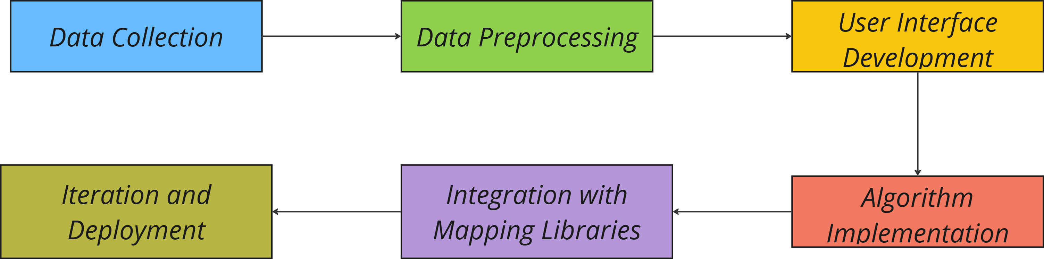
Methodology
The methodology includes collecting and preprocessing city maps, developing a user interface, implementing modified algorithms for route optimization, integrating mapping libraries for visualization, and refining the application based on feedback before deployment.

Slide 7
Tools and Technologies
• Programming Languages: JavaScript
• Front-End Development: Jquery, HTML, CSS
• Mapping and Visualization: Google Maps API, Downloaded Maps and Images, Raphael.js (JS visualization)
• Algorithm Implementation: Use of path finding algorithms like A* and Djikstra’s in a modified manner.
• Version Control: Git and GitHub for version control and collaboration.

Slide 8
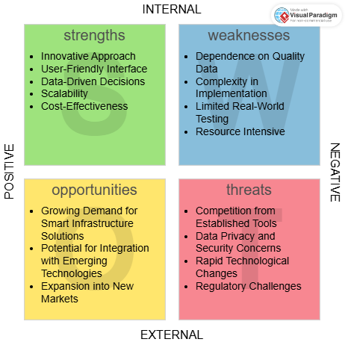
SWOT Analysis
SWOT Summary: The project leverages innovative route optimization for navigation applications, offering a user-friendly, data-driven solution. However, challenges include dependence on high-quality data and competition from established tools, which may impact its adoption and effectiveness.

Slide 9
Areas of Application
Urban Planning and Infrastructure Development
Pathfinder AI can help optimize road networks and transportation systems, reducing congestion and improving city layouts by calculating efficient routes.
Logistics and Supply Chain Management
It can optimize delivery routes, reducing costs and delivery times by determining the most efficient paths, benefiting industries like e-commerce and freight management.
Emergency Response and Disaster Management
Pathfinder AI can enable faster emergency responses by suggesting the quickest routes for ambulances, fire trucks, and rescue teams in real-time.
Geographic Information Systems (GIS) and Mapping
It can integrate with GIS to optimize pathfinding, aiding in projects like land-use planning, flood modeling, and environmental conservation.

Slide 10

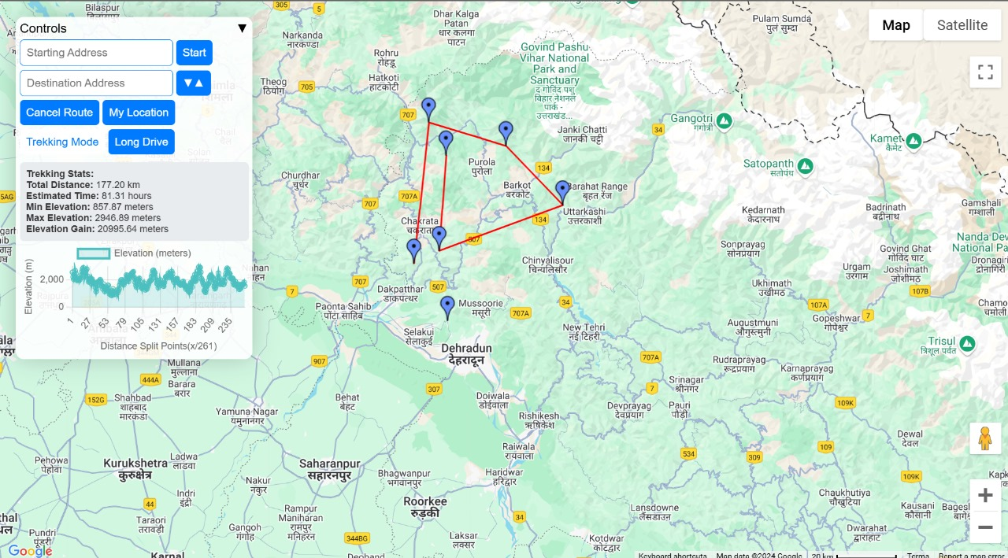
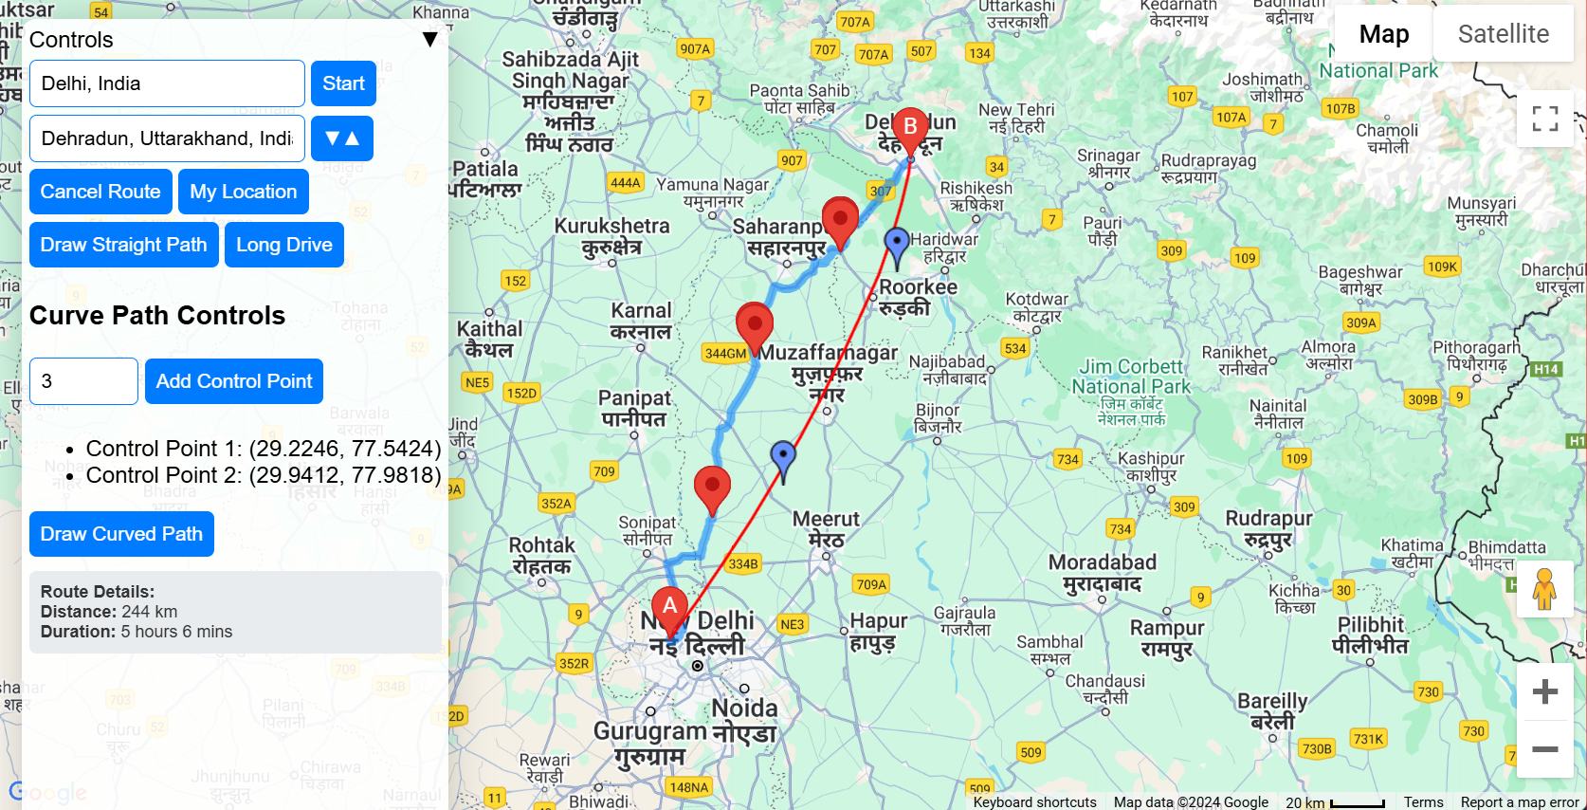
Current Progress
Created a sign-up page for the application, allowing new users to register and create an account for access to the system.

Slide 11
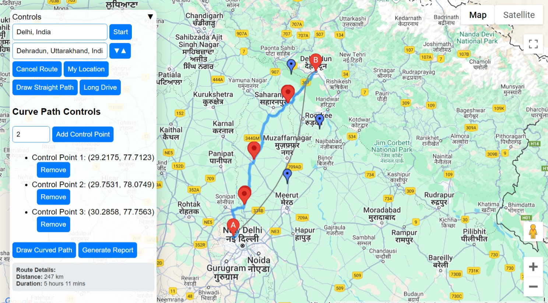
Current Progress
Implemented Bezier curves using De Casteljau's algorithm to enhance the straight path by adding smooth, curved modifications. Allowing for more flexible and natural path adjustments, improving the overall routing accuracy and visual representation of the path. The use of De Casteljau's algorithm ensures precise control over the curve, providing a high level of customization and visual appeal to the pathfinding solution.

Slide 12
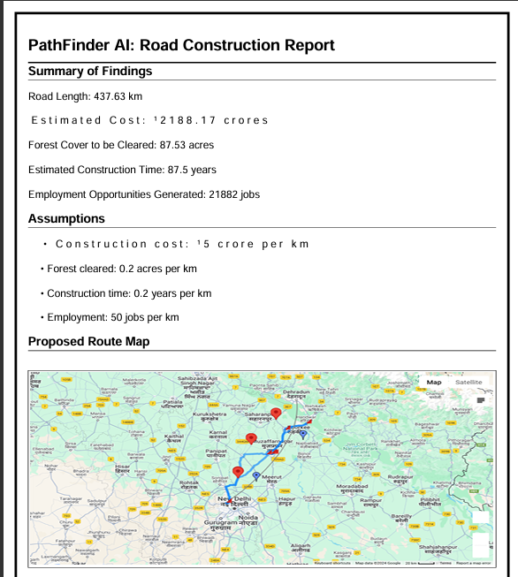
Current Progress
The report generation functionality allows users to automatically generate detailed reports based on the route planning and algorithm visualizations. This feature captures key information, such as the selected paths, algorithms used, and the performance of different routing strategies, and presents it in a well-organized format. The generated reports can be easily saved or exported for further analysis or sharing, providing valuable insights and documentation for users and stakeholders involved in the project.

Slide 13
Achieved Deliverables
Achieved Objectives:
1. Route Visualization
Successfully implemented route plotting on the map using Google Maps API.
Integrated functionality for displaying straight paths and curved paths (Bézier curves) between selected points.
2. Pathfinding with Dijkstra's Algorithm
Implemented Dijkstra's algorithm for calculating the shortest path between two points.
Enabled dynamic graph generation from user-added control points and markers.
Displayed the shortest path on the map as a highlighted polyline.
3. User Interaction Features
Enabled users to add and remove control points dynamically on the map.
Provided interactive options to reverse the route or adjust markers for flexible route planning.
4. Cost and Impact Estimation
Developed a report generation system that:
Estimates construction costs based on road length.
Evaluates environmental impacts like forest cover cleared.
Calculates estimated construction time and employment opportunities.
5. Map Integration
Integrated Google Maps API with support for:
Real-time geocoding of start and end points.
Autocomplete for user inputs (e.g., start and end locations).
Calculation of distances and directions between points.

Slide 14
Achieved Deliverables
Achieved Objectives:
6. Elevation Data Integration
Incorporated elevation data for trekking routes using Google Maps Elevation API.
Displayed elevation statistics, such as total gain and estimated trekking time, for user-selected paths.
7. Customizable Trekking and Long Drive Modes
Implemented a trekking mode with support for adding multiple trekking markers and calculating cumulative distances.
Developed a long drive mode for generating scenic routes and evaluating round-trip paths.
8. Map Interaction Enhancements
Allowed users to interact with the map for:
Adding custom control points by clicking.
Viewing landmarks and nearby places dynamically based on the chosen path.
9. Report Generation
Automated generation of a detailed PDF report with:
Route statistics, cost, and time estimations.
Impact analysis and recommendations for sustainable road construction.
Screenshot of the proposed route map.
10. Modular and Extendable Codebase
Designed a modular graph class to handle dynamic graph creation and shortest path calculations.
Created reusable functions for adding, removing, and updating markers, making the project extensible for future features.

Slide 15
Scope for Future Refinements
Yet to implement Objectives:
Improvising the algorithm associated with deviation for the roadway.
Adding features like heatmaps, 3d integration etc.
Options to upload custom city-wide maps, to be able to work with various formats like .tiff, .bmp, .shp, geojson and other raster and vector formats.
Report generation mentioning details like cities selected, selected route, cost estimation, impact etc.
Adding educational features, that guide the user through the interface of application.
Integrate Elevation and other factors like community dynamics, Historical Data Analysis, job opportunities etc. for a more comprehensive view of the application.

Slide 16
References
https://docs.mapbox.com/help/glossary/mapbox-js/
Google Maps Platform. (n.d.). Google Maps API Documentation.
Project Management Institute. (2017). A Guide to the Project Management Body of Knowledge (PMBOK Guide) (6th ed.).
https://www.youtube.com/watch?v=J7eyI1ClDOA
https://www.iirs.gov.in/iirs/sites/default/files/pdf/2023/Overview_of_Remote_Sensing_and_GIS_Applications_E-Book.pdf
https://www.sciencedirect.com/journal/isprs-journal-of-photogrammetry-and-remote-sensing

